Slide 1
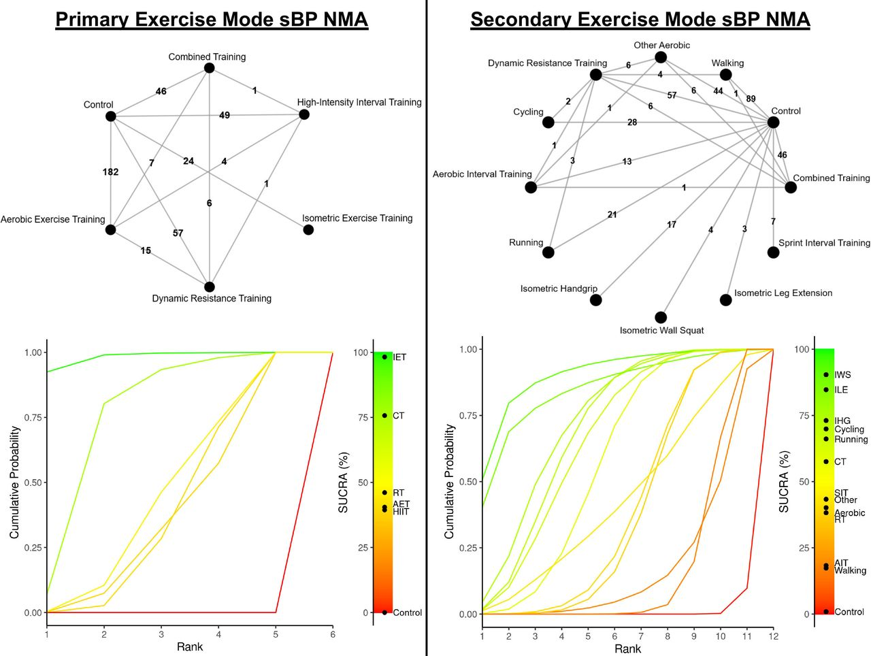

Network diagrams depicting the direct and indirect comparisons for the primary and secondary network meta-analyses and corresponding Bayesian ranking panel plots.
Jamie J Edwards et al. Br J Sports Med 2023;57:1317-1326
Copyright © BMJ Publishing Group Ltd & British Association of Sport and Exercise Medicine. All rights reserved.
Notes:
Network diagrams depicting the direct and indirect comparisons for the primary and secondary network meta-analyses and corresponding Bayesian ranking panel plots. AET, aerobic exercise training; AIT, aerobic interval training; CT, combined training; HIIT, high-intensity interval training; IET, isometric exercise training; IHG, isometric handgrip; ILE, isometric leg extension; IWS, isometric wall squat; NMA, network meta-analysis; RT, dynamic resistance training; SBP, systolic blood pressure; SIT, sprint interval training; SUCRA; surface under the cumulative ranking curve.

